Slide 1
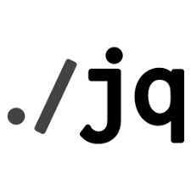

Jq Command Tutorials
NarendraP
Jq Command for Bash Shell Scripting

Slide 2
Prerequisites for this Course: Jq Command Tutorials
Linux/Mac System to Practice
Knowledge on Command Line
Usage of Pipeline and redirection
Example:
echo “Welcome to JQ Tutorials” | grep “JQ”
grep “JQ” <<< echo “Welcome to JQ Tutorials”
Basic Knowledge on JSON Data Structure
Knowledge on any editor like vi/vim/vcode etc…
Basic Knowledge on Bash Shell Scripting
Note: We will use rest api response and AWS CLI Commands Output while doing practice.
Jq is a command-line utility to parse JSON Data

Slide 3
What You Will Learn Here:
Jq command usage to work with JSON Data or Parsing JSON Data With Jq
Usage of Jq command in bash shell scripts
Jq is a command-line utility to parse JSON Data

Slide 4
Thank you

